Slide 1

SDP Mid-term evaluation
Demystifying the housing market: Unveiling the power of machine learning in Price forecasting
Supervised By: Dr. Rakesh Ranjan Swain
Group No.: T-17
Name of the Student(s) Regd. No.:
Swayam Prakash Sahu 2041019089
Ansuman Patro 2041016171
Swayam Samantaray 2041019136
Anuj Pratap Singh 2041019240
Department of Computer Sc. and Engineering
Faculty of Engineering & Technology (ITER)
Siksha ‘O’ Anusandhan (Deemed to be) University
Bhubaneswar, Odisha
1

Slide 2
Presentation Outline
Introduction
Motivations
Uniqueness of the work
Literature Survey
Existing System
Problem Identification
Schematic Layout OR Model Diagram
Methods OR Tools OR Algorithms used
Experimentation and Results
System Specifications
Datasets Description
Parameters used (if any)
Experimental outcomes (Tables and Figures)
Summary (Key findings)
Bibliography
2

Slide 3
Introduction
Overview
Objective: Utilize machine learning to decode housing price complexities.
Approach: Analyze trends and employ innovative techniques for accurate predictions.
Impact: Foster transparency and fairness in the housing market.
Empowerment: Enable informed decisions for buyers and sellers.
Vision: Cultivate a brighter urban future through data-driven insights.
3

Slide 4
Introduction contd..
Motivations
Stabilizing Market Dynamics: Predicting housing prices offers stability amidst market fluctuations, aiding both buyers and sellers in making well-informed decisions.
Financial Clarity: Accurate forecasts empower individuals to plan effectively, negotiate confidently, and achieve their housing goals with financial certainty.
Promoting Accessibility: By revealing areas of affordability, the project fosters inclusivity, allowing more individuals to access suitable housing options within their budget.
Optimizing Investments: Investors benefit from timely insights, enabling strategic decisions that maximize returns and minimize risks in the dynamic real estate landscape.

Slide 5
Literature Survey
Author/Year | Title | Domain | Technique | Citations | Findings
N Ragapriya et al/ 2023 | Investigated the effectiveness of various machine learning models for predicting house prices. | Machine Learning | Modified Extreme Boosting(XGBoost ) | [1] | The study found that Modified Extreme Gradient Boosting (XGBoost) outperforms competing prediction algorithms for forecasting changes in home prices.
Felix Lorenz et al/ 2023 | Investigated the application of interpretable machine learning (IML) to enhance the analytical capabilities of hedonic modeling in real estate. | Machine Learning | XGBoost (XGB) | [2] | The study found that size and age are the most important drivers of rent. IML methods provide detailed insights, revealing higher rents for certain combinations of characteristics.

Slide 6
Literature Survey
Author/Year | Title | Domain | Technique | Citations | Findings
G. Naga Satish et al/ 2019 | Investigated various machine learning algorithms to predict future housing prices. | Machine Learning | Lasso Regression | [3] | The study found that Modified Extreme Gradient Boosting (XGBoost) outperforms competing prediction algorithms for forecasting changes in home prices.
Guangjie Liu et al/ 2022 | Investigated the use of a multiple linear regression model to predict real estate prices in China. | Machine Learning | Multiple Linear Regression (MLR) | [4] | The study found that the real estate price prediction model, using the least square method, has a maximum error of 8%, indicating high accuracy in predicting house prices.

Slide 7
Literature Survey Contd..
Problem Identification
1. Escalating Housing Costs: The continuous rise in urban housing prices is making it harder for middle-class families to purchase homes within their financial means.
2. Market Competition: Increasing competition in the housing market intensifies the challenge for buyers to find affordable options and for sellers to price their properties competitively.
3. Uncertainty in Real Estate Transactions: The lack of accurate forecasting tools leaves both buyers and sellers uncertain about the true value of properties, which can lead to suboptimal decisions.
4. Complexity of Housing Price Determinants: Housing prices are influenced by various factors such as location, area, and amenities, making it difficult to predict prices without sophisticated analytical tools.
5. Inadequate Existing Forecasting Methods: Traditional forecasting methods often fall short in capturing the complexity and dynamics of the housing market, resulting in less reliable predictions.

Slide 8
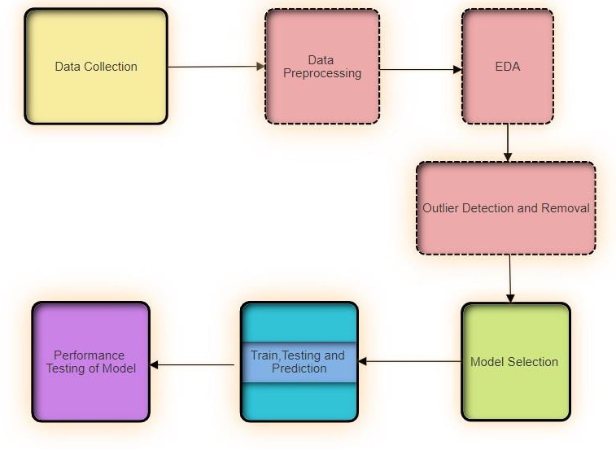
Model Diagram
7

Slide 9
Experimentation and Results
System Specification :
Hardware :
Processor :- Intel i5 11th generation with 4 core and 2.4 GHz with Turbo Boost up to 4.2 GHz.
RAM :- 8gb DDR4 with ram frequency of 3200 MHz .
Storage :- 256GB SSD and 1TB Hard disk.
Software :
Operating System : Window 11
Development Environment : Python programming language is used along with its different
libraries like Scikit learn.
Libraries and Frameworks : Python libraries like pandas, NumPy for data cleaning and Matplotlib,
seaborn for data Visualization.
IDE : Anaconda, Jupyter Notebook and Vs Code

Slide 10

Tools and Algorithms
For the implementation of the given model different tools and algorithms are used till now. Firstly the dataset which is used in the model training and testing process is Kaggle notebook for dataset- Bangalore home price dataset. Hence different tools and algorithms are mentioned below.
Different Tools which are used :
For Data Cleaning :- Pandas and NumPy
For Data Visualization :- Matplotlib and Seaborn
For Machine Learning Model Implementation :- scikit-learn and its Libraries
Software Used :- Jupyter notebook and Vs Code
Different Algorithms used for model training till now :
Decision tree
Linear Regression
Lasso Regression
8

Slide 11
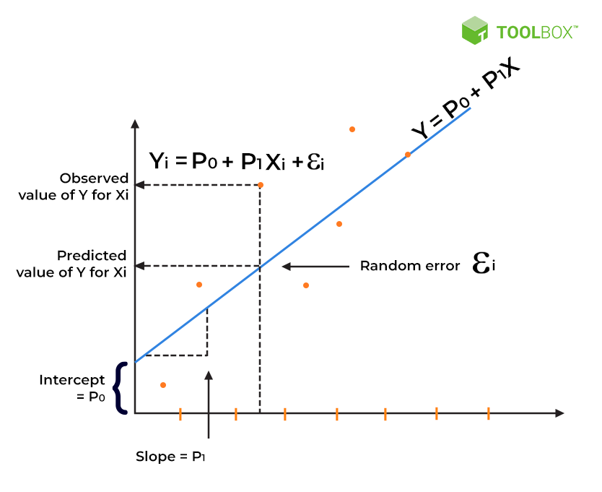
Tools and Algorithms Contd..
Linear Regression:-
Linear regression analysis is used to predict the value of a variable based on the value of another variable
Formulation:-

Slide 12
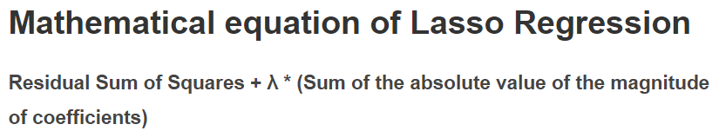
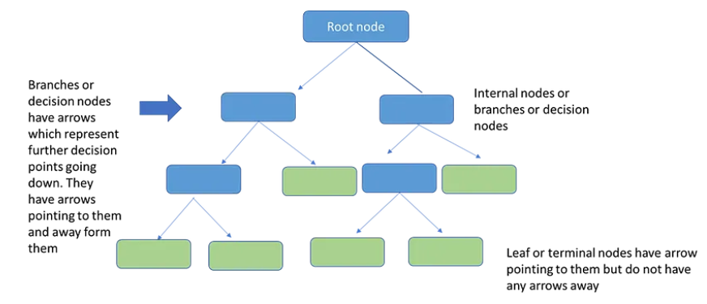
Tools and Algorithms Contd..
Lasso Regression
The word “LASSO” stands for Least Absolute Shrinkage and Selection Operator.
Lasso regression, also known as L1 regularization, is a linear regression technique that adds a term to the cost function to reduce overfitting. The goal is to minimize the sum of the absolute values of the coefficients, which leads to some coefficients being set to zero, effectively selecting the most important features.
Decision Tree
A decision tree is a supervised learning algorithm that uses a tree-like model to classify data or make predictions. It works by recursively partitioning the data into smaller subsets based on the values of the input features.

Slide 13
Experimentation and Results Contd..
Datasets Description And Parameters used :
Kaggle notebook for dataset-Bangalore house prices dataset(13320 X 9) :
This project revolves around predicting housing prices by analyzing various parameters such as area type, availability, location, size, society, total square footage, number of bathrooms, number of balconies, and price. Drawing inspiration from real estate datasets, the objective is to build accurate models that forecast property prices, aiding stakeholders in making informed decisions in the housing market.
area_type: Type of area (e.g., Super built-up Area, Plot Area, Built-up Area)
availability: Availability status (e.g., Ready To Move, 19-Dec)
location: Location of the property (e.g., Electronic City Phase II, Chikka Tirupathi)
size: Size of the property in terms of bedrooms (e.g., 2 BHK, 4 Bedroom)
society: Name of the society or residential complex (e.g., Coomee, Theanmp)
total_sqft: Total area in square feet
bath: Number of bathrooms
balcony: Number of balconies
price: Price of the property

Slide 14
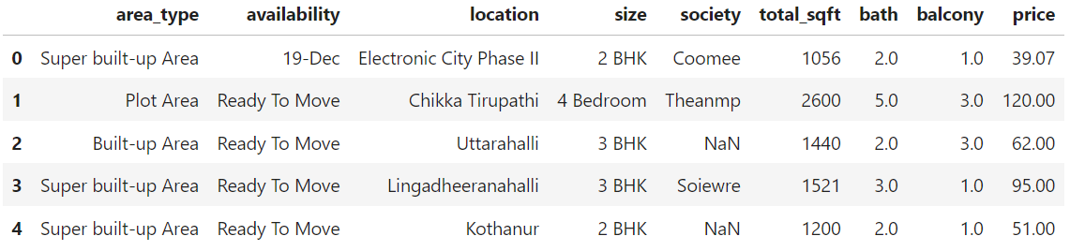
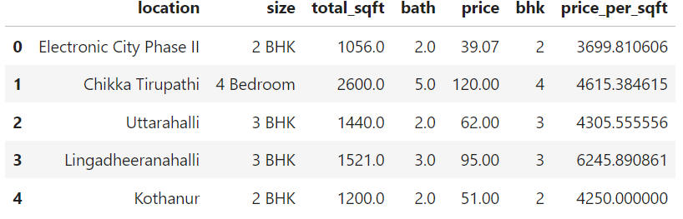

Experimentation and Results Contd..
Exploratory Data Analysis :
Firstly we import all the libraries of python in our IDE. Then we import the dataset for data cleaning. The dataset consists of 9 columns and 13320 datapoints.
Then we perform Exploratory data analysis in which firstly we check the density function of the label with given features.
After that we check the number of null values and missing values in the particular features, then we perform a function over it with which we replace the null value with the median value based on the outcome. Below table show the changes.

Slide 15
Experimentation and Results Contd..
Outlier Detection and Removal :
Outlier are those data points which doesn’t exhibit the same characteristic then the rest of the points
which can further lead to create a huge problem during the prediction of the value.
Deviations from the standard bathroom-to-bedroom ratio are removed to maintain data integrity
Dimensionality reduction labels locations with fewer than 10 data points as "other," streamlining analysis and enhancing one-hot encoding efficiency.
Properties failing to meet the square footage per bedroom threshold are identified as outliers and removed.
By adhering to business-driven criteria such as bathroom-to-bedroom ratios, dimensionality reduction for location data, and enforcing a square-foot per bedroom threshold, we have effectively cleaned our dataset, ensuring its integrity and reliability for subsequent analysis and modeling endeavors.

Slide 16
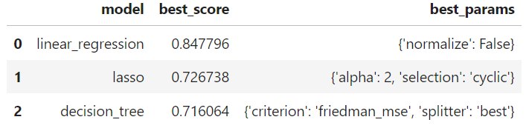
Experimentation and Results Contd..
(Experimental outcomes )
Training, Testing and Performance Analysis
Till now we used three machine algorithms using sckit-learn and its libraries. One is linear regression, lasso and decision tree.
After training and testing the model based on the given dataset we find linear outperform Lasso regression with a good accuracy of 84%.
Below is the best_score of the given three algorithms which showcase the performance of the
machine.

Slide 17
Uniqueness
Location-based pricing: The project takes into account the location of the property, which is a crucial factor in determining the price of a house.
Comprehensive feature engineering: The project uses a range of features, including square footage, number of bedrooms and bathrooms, and location, to build a robust model.
Handling outliers and missing values: The project uses techniques such as mean and median imputation to handle missing values and outlier detection and removal to ensure that the model is not biased by extreme values.
Use of GridSearchCV for hyperparameter tuning: The project uses GridSearchCV to tune the hyperparameters of the Lasso and Decision Tree models. This process allows the model to be as accurate as possible.
Visualization of results: The project uses visualizations such as a bar graph of feature importance to better understand the correlation between the features and the target variable.

Slide 18
Limitations
Lack of Real-time Data: The model is trained on historical data, which may not reflect current market trends or changes in the real estate market.
Geographic Limitations: The model is trained on data from Bangalore, which may not be applicable to other cities or regions.
User Input Errors: The website relies on user input for features like square footage and number of bedrooms. If users enter incorrect or inaccurate information, the model's predictions may be inaccurate.
Dependence on variables: The project relies on several variables such as location, square footage, and the number of bedrooms and bathrooms. Any change in these variables could affect the model's predictions.

Slide 19
FUTURE PLANS
Developing a more robust and scalable architecture for the website and model deployment.
Incorporating real-time data and updating the model periodically.
Expanding the model to cover more geographic regions.
Implementing input validation and error handling on the website.

Slide 20
Summary
Data Preprocessing and Visualization: Used NumPy and Pandas for thorough preprocessing of housing data, while Matplotlib aided in visualizing complex relationships between variables.
Model Development: Employed Linear Regression, Lasso Regression, and Decision Trees to construct robust models for forecasting housing prices, leveraging diverse urban parameters.
Accuracy and Precision: Achieved high accuracy and precision in forecasting housing prices, surpassing traditional methods, through advanced algorithms and extensive data analysis.
User-Friendly Interface: Created intuitive interfaces with HTML, CSS, and JavaScript for easy navigation through predicted housing prices, enhancing accessibility for stakeholders.
15

Slide 21
Bibliography
Ragapriya, N., T. Ananth Kumar, R. Parthiban, P. Divya, S. Jayalakshmi, and D. Raghu Raman. "Machine Learning Based House Price Prediction Using Modified Extreme Boosting." Asian Journal of Applied Science and Technology (AJAST) 7, no. 1 (2023)
Lorenz, Felix, Jonas Willwersch, Marcelo Cajias, and Franz Fuerst. "Interpretable machine learning for real estate market analysis." Real estate economics 51, no. 5 (2023)
Liu, G. (2022). Research on prediction and analysis of real estate market based on the multiple linear regression model. Scientific Programming, 2022, 1-8.
Satish, G. Naga, Ch V. Raghavendran, MD Sugnana Rao, and Ch Srinivasulu. "House price prediction using machine learning." Journal of Innovative Technology and Exploring Engineering 8, no. 9 (2019)

Slide 22

17

